Slide 1
Creating a Test Timeline
The How, When, and Why of Scheduling Standardized Tests

Slide 2
How many times should you take each test?
Some things to consider:
What do colleges require you to submit?
What score are you aiming for?
What is your budget?
*It is recommended that you take the SAT and/or ACT 2-3 times, and definitely no more than 4
Notes:
Definitely recommended that they do not pass 3 exams

Slide 3
What do colleges require you to submit?
Most colleges require at least one set of ACT/SAT test scores
Some (mostly private universities) will require SAT subject tests
When you submit your test scores, you can choose which scores to submit
Some colleges will require you to send all of your scores, and they may consider all or take a superscore
Notes:
Talk to the mentee about their college options so far, you can take the time to look up some examples with them

Slide 4
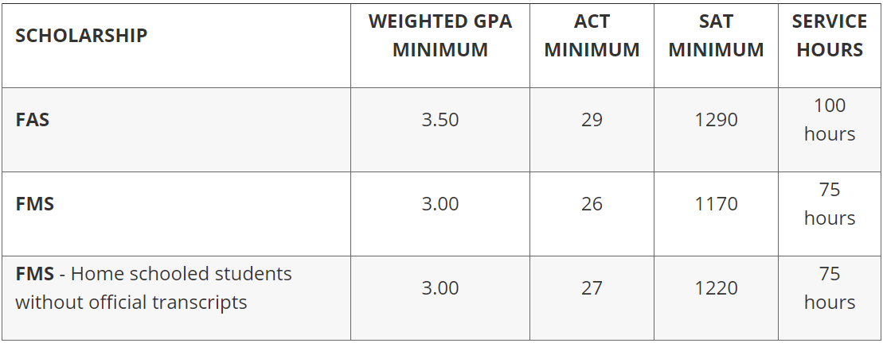
What score are you aiming for?
Look at the student profiles of the universities you are considering and find the score ranges of the admitted students - you want to be in or above this range*
Consider the minimum requirements for Bright Futures**:
Notes:
*The ranges for SAT may reflect the old test
**These minimum requirements are subject to change
75th percentile is highest, you want to meet or exceed this (if the info is available)
We will discuss Bright Futures more later Look up one of you mentees potential colleges and find that score range/average

Slide 5
What can you budget?
All of our mentees qualify for 2 SAT fee waivers, 2 SAT Subject Test fee waivers, and 2 ACT fee waivers which they can pick up from their guidance counselor
Cost of SAT: $57 with essay
Cost of ACT: $58.50 with essay
Cost of SAT Subject Test: $26 + $20 for each additional test in one sitting (up to 3 tests total)
More information here and here

Slide 6
When should I take these tests?
Is your school automatically signing your class up for any tests?
By when do you need to submit these scores?
Recommendations:
Take one of each main test in the spring
Retake the test you feel strongest about, if necessary, in the summer
Take the test a third time, if necessary, in the fall BEFORE your applications are due
SAT August October November December March May June
ACT September October December February April June July
Notes:
If you already know from practice tests that you are much better at one than the other then just focus on the one
After taking one of each test, you should be able to gage which test you want to focus on and take a second time if you are not already happy with your first scores
You can keep taking both tests if you want
Before your applications are due means you give yourself time to also wait for the scores to come out and send them to colleges

